Slide 1


Variant Analysis and Interpretation
Deanna M. Church
Senior Director of Genomics and Content
Personalis, Inc
@deannachurch
Short Course in Medical Genetics 2013

Slide 2
Analyzing and interpreting variants
Analytical Validity
Our ability to reliably identify variants
Clinical Validity
Our ability to reliably associate variants
with a disease.
Notes:
Slide- difference between discovery and research

Slide 3

Analyzing and interpreting variants

Slide 4
Analyzing and interpreting variants
Analytical Validity

Slide 5
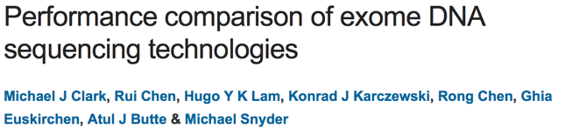
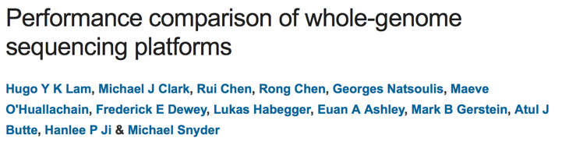
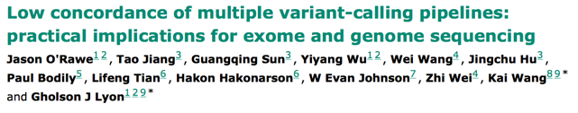
Standard Exomes and Genomes are not “Finished”

Slide 6
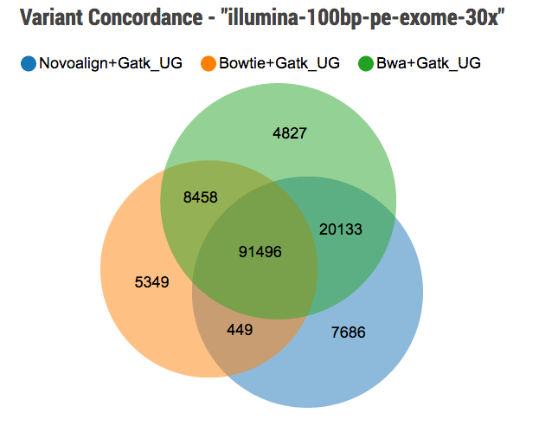
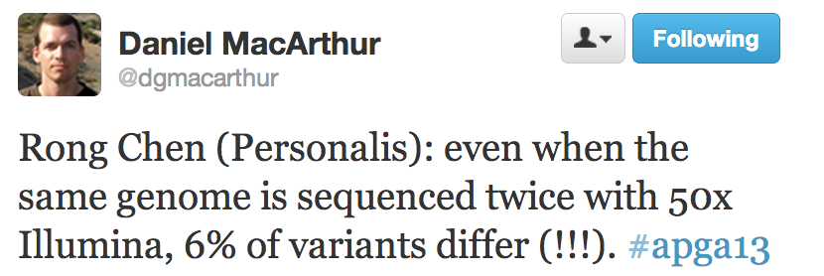
http://www.bioplanet.com/gcat

Slide 7
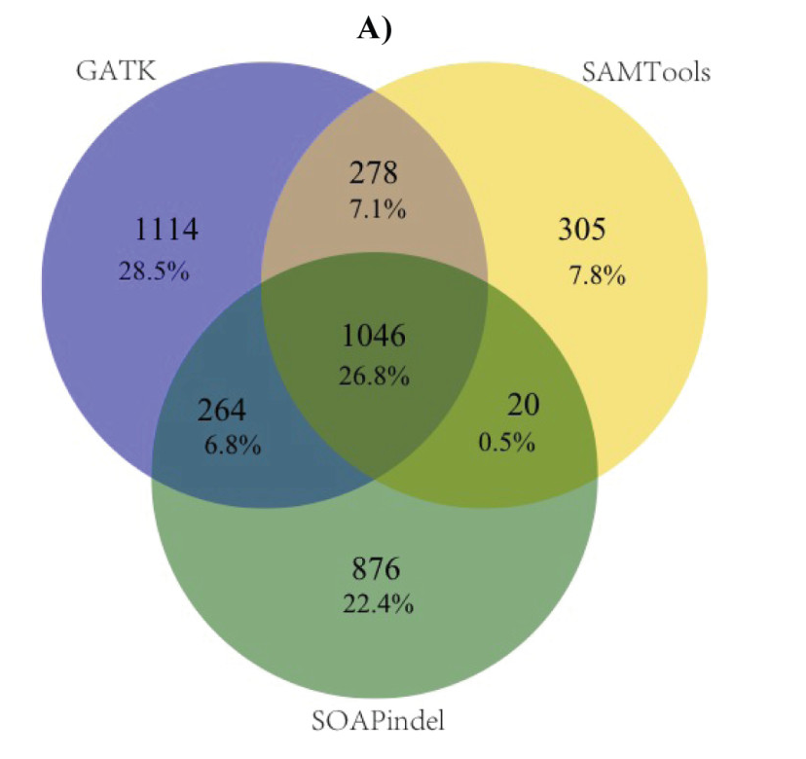
Indels
Rawe et al, 2013

Slide 8
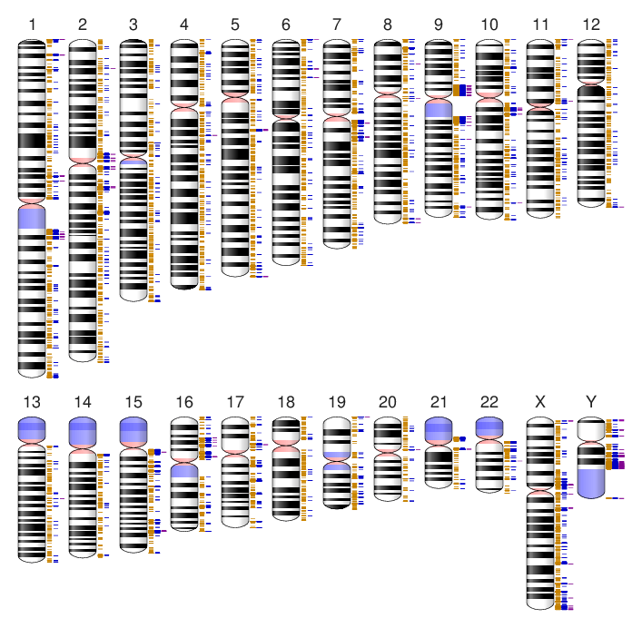
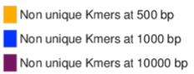

Slide 9
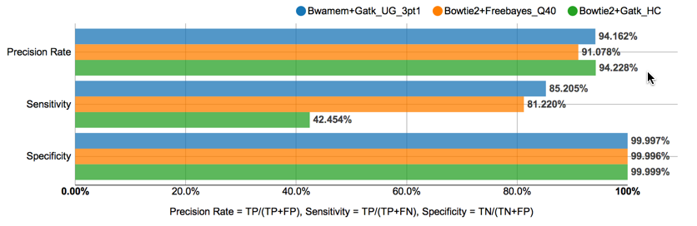
Most research pipelines tuned to limit false discovery
http://www.bioplanet.com/gcat

Slide 10
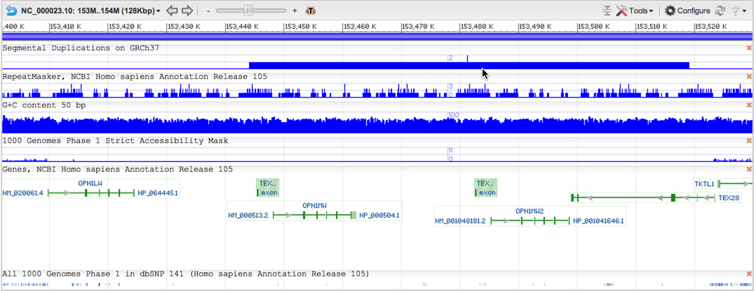
GRCh37.p13 (GCF_000001405.25)Chr X (NC_000023.10):153.4M - 153.5M
http://www.ncbi.nlm.nih.gov/variation/view/?cfg=NCID_1_5296314_130.14.18.128_9146_1406167515_2716676379

Slide 11
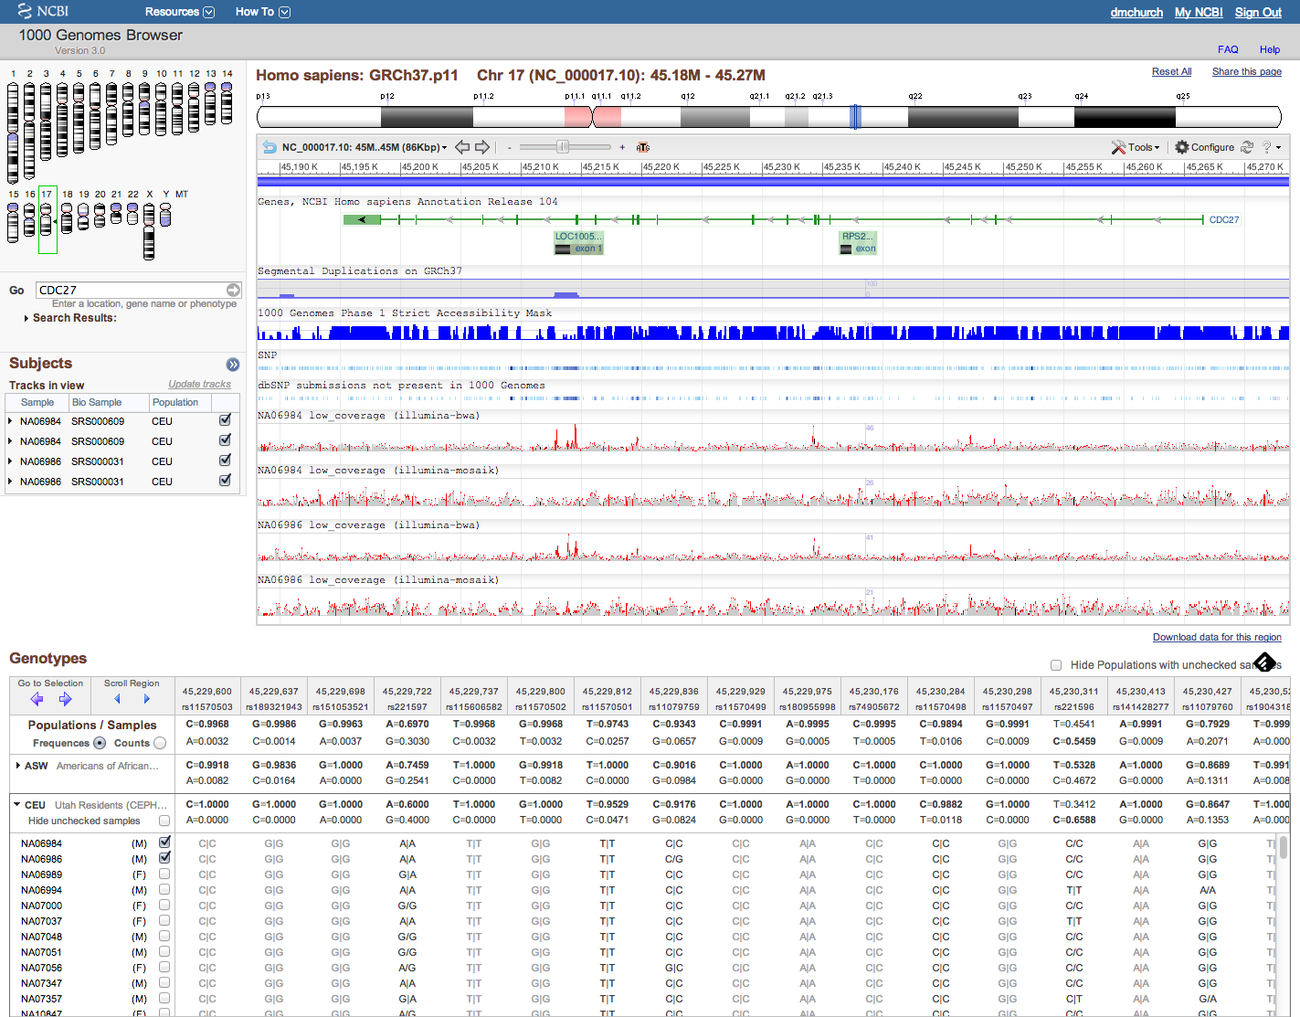
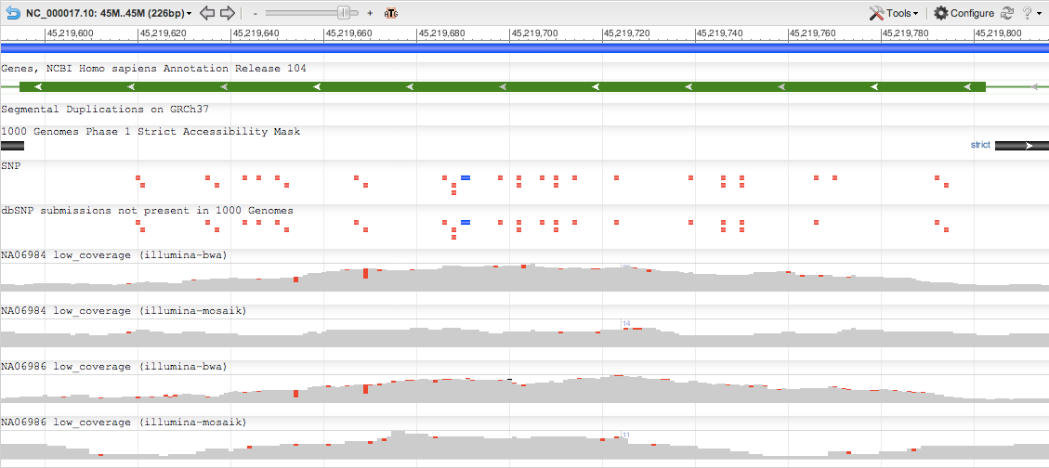
CDC27
1KG Phase 1 Strict accessibility mask
SNP (all)
SNP (not 1KG)
http://www.ncbi.nlm.nih.gov/variation/tools/1000genomes

Slide 12
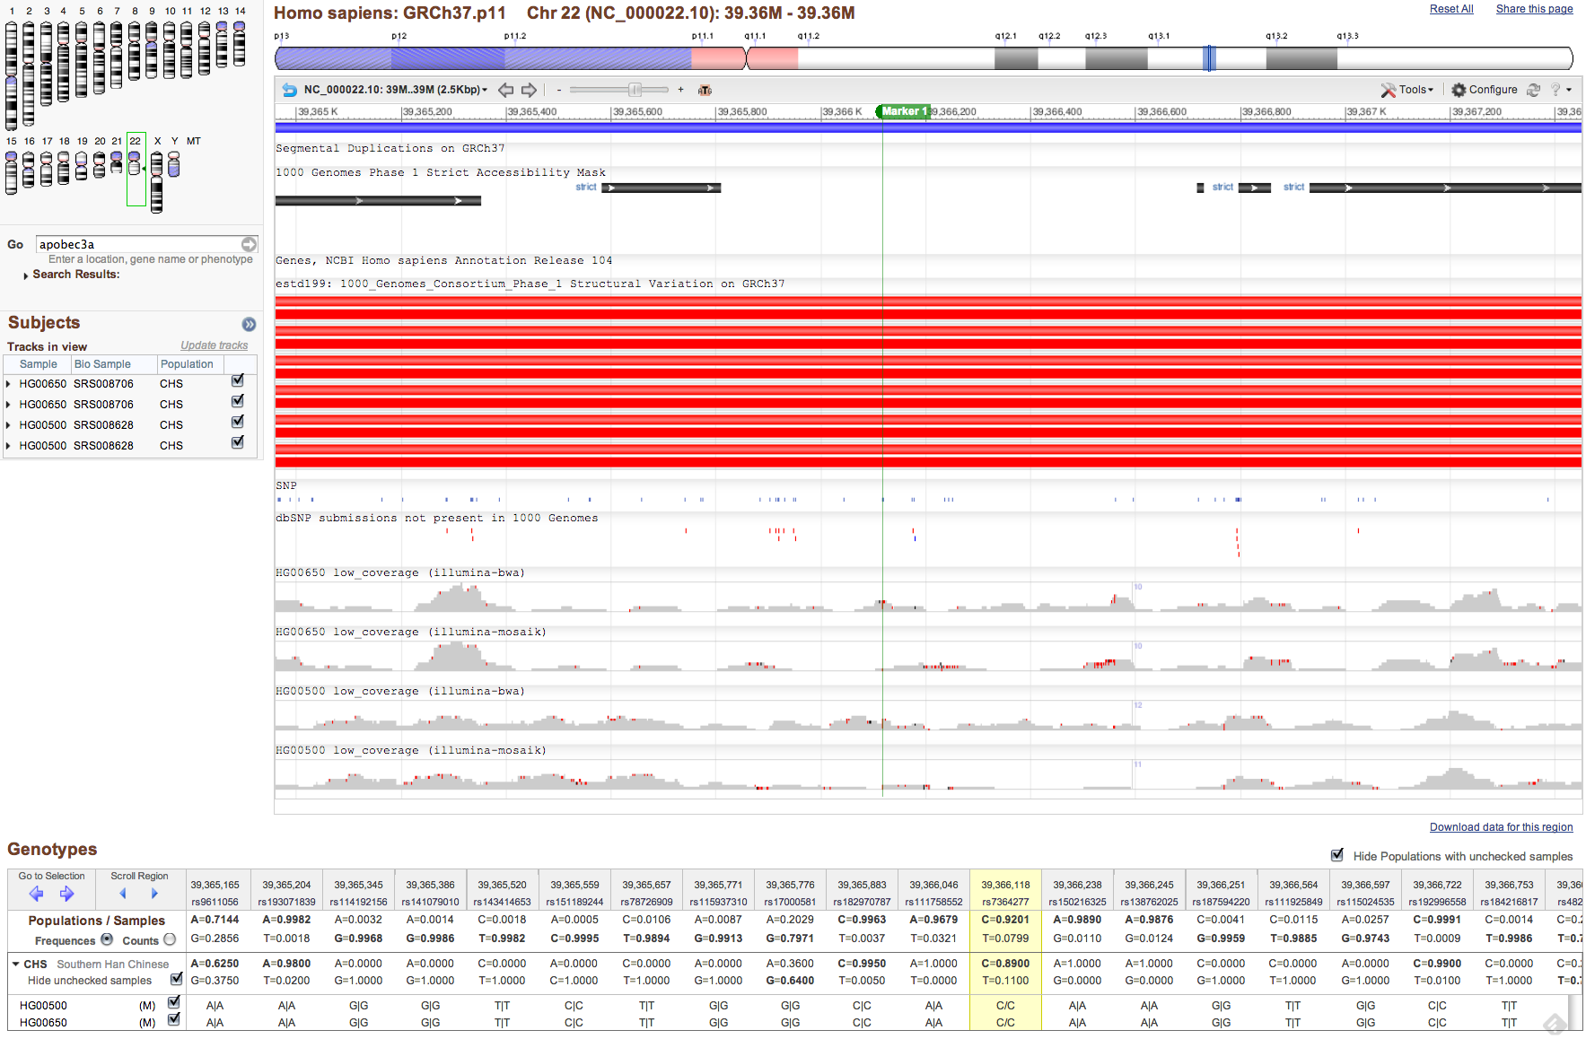
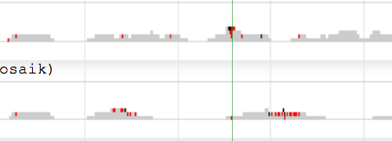
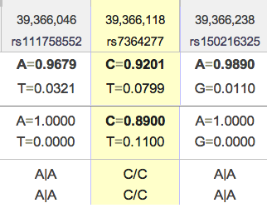
http://www.ncbi.nlm.nih.gov/variation/tools/1000genomes

Slide 13
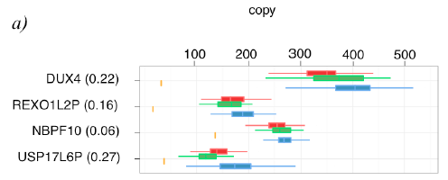
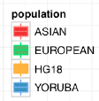
Sudmant et al., 2010

Slide 14
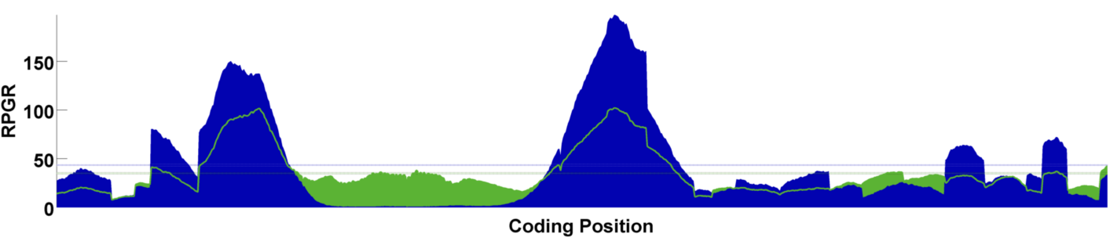
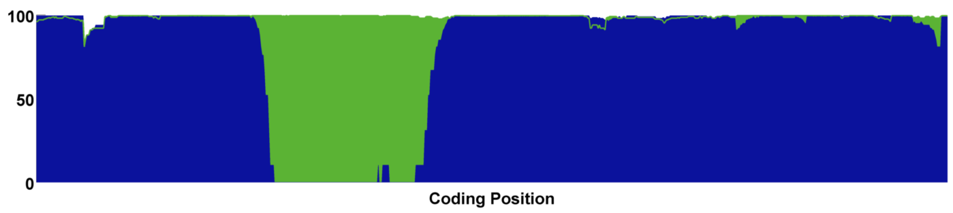
Standard Exomes Don’t Cover the Whole Exome
Mutations in RPGR cause ~80% of X-linked retinitis pigmentosa
Read depth
Sensitivity to detect heterozygotes
Augmented Clinical Exome
Standard Exome

Slide 15
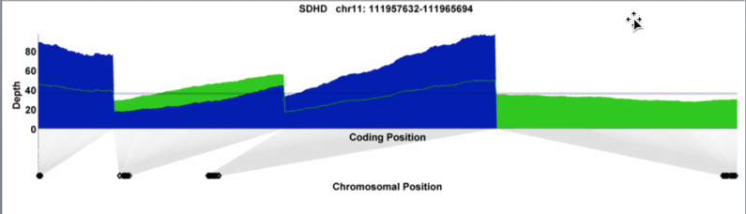
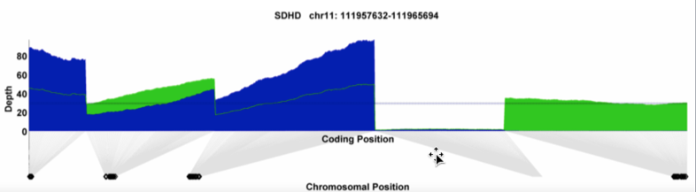
Standard Exomes Don’t Cover the Whole Exome
NM_003002.3 (reference transcript)
NM_001276506.1 (new RefSeq Transcript)

Slide 16


Slide 17
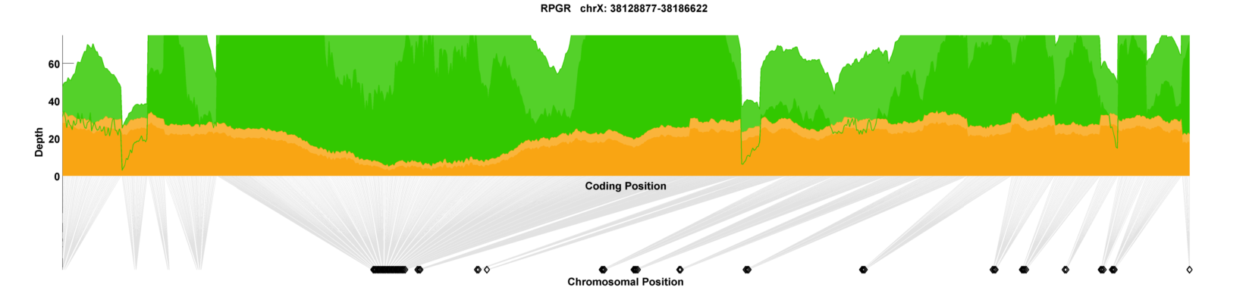
Whole Genome Sequencing Does Not Completely Solve the Accuracy Challenges
Depth Coverage Plot of RPGR
Previously described variants
>25x coverage (required to call heterozygous SNVs and indels accurately)
Augmented Clinical Exome™ (12G)
Standard Whole Genome (100G) - Dark orange represents coverage at 1 sigma from mean

Slide 18
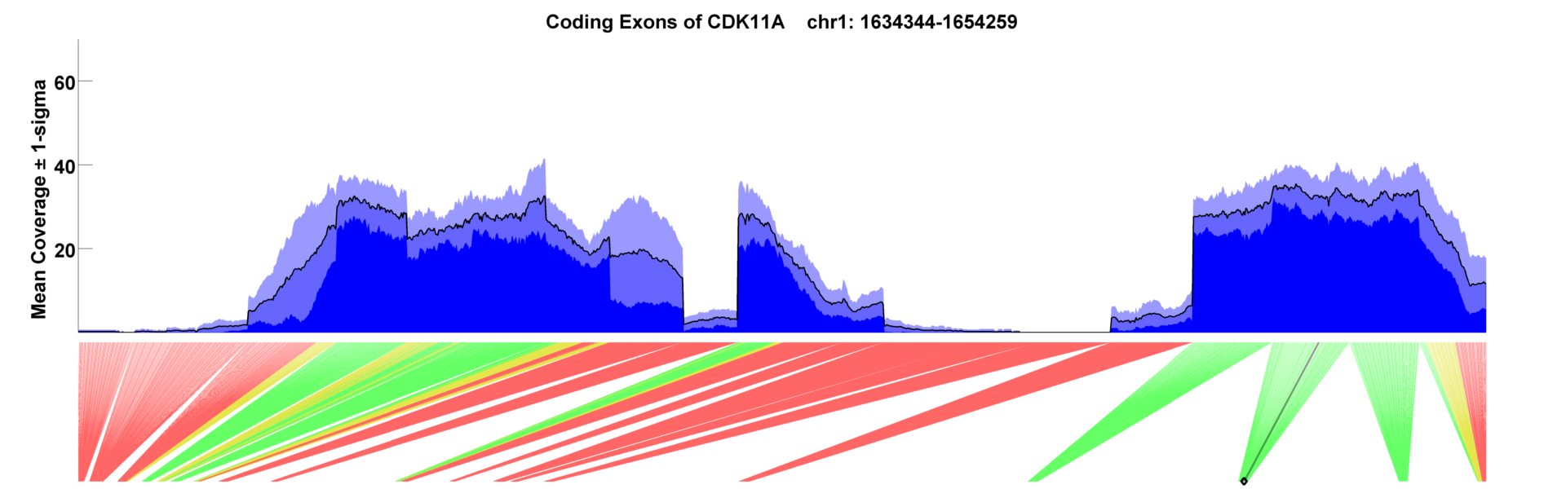
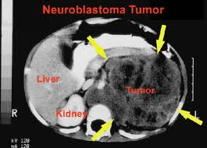
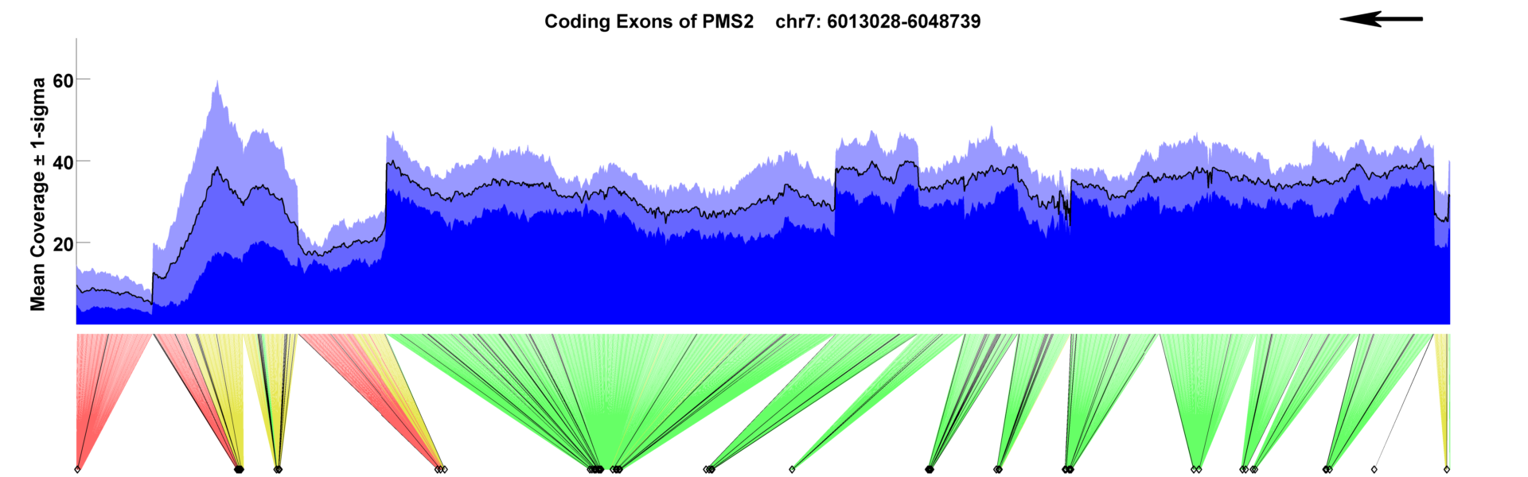
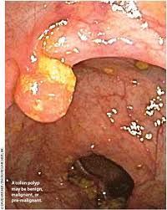
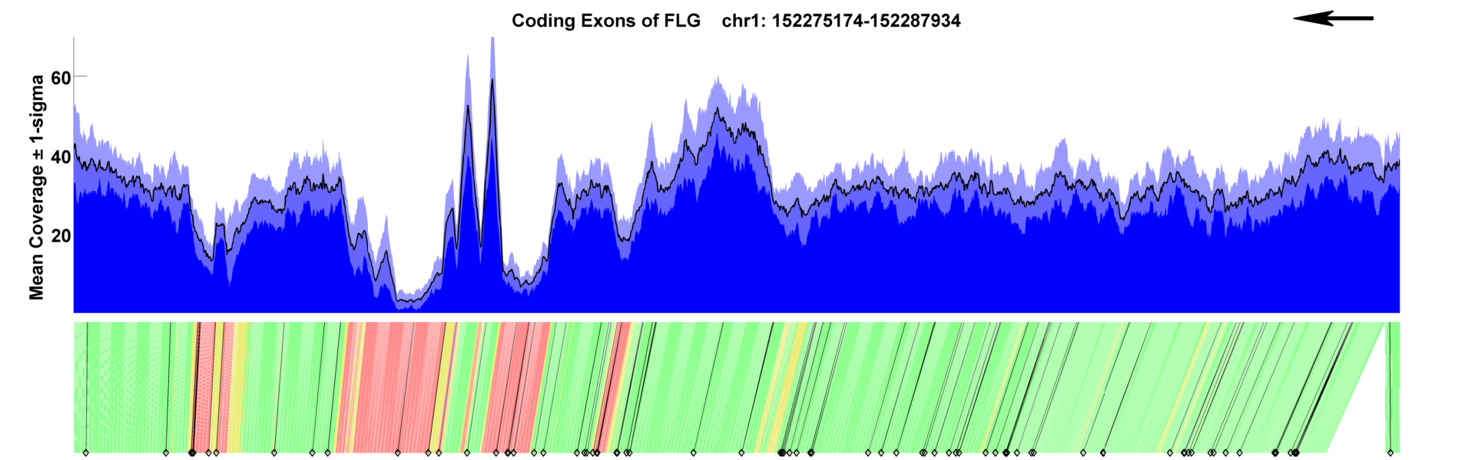
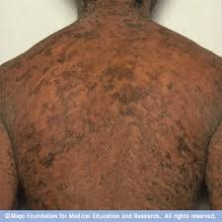
Standard Genomes Don’t Cover the Whole Genome
CDK11A
Neuroblastoma
PMS2
Lynch syndrome
FLG
Ichthyosis Vulgaris
(Nat Gen 2007)

Slide 19
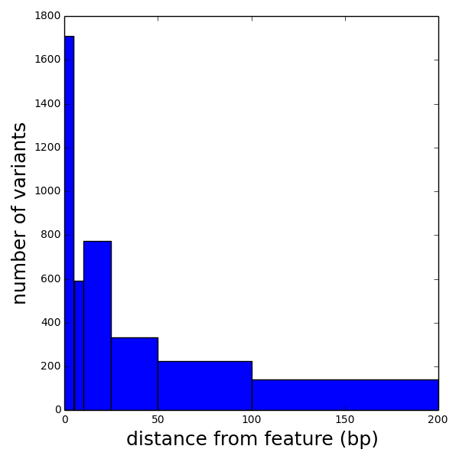
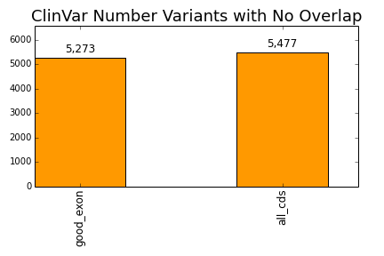
Most of what we know is in the context of genes
ClinVar: 55,467 variants*
Distance of non-overlapping variants to closest high quality exon feature
Variants with no overlap
High quality Exons
Any CDS
* With a genomic location as of 03/07/2014

Slide 20


Standard Exomes and Genomes are not “Finished”
WGS cost > WES cost.
Still need to supplement WGS to get full gene coverage.
Most interpretation is in the context of genes.

Slide 21
Analyzing and interpreting variants
Clinical Validity

Slide 22
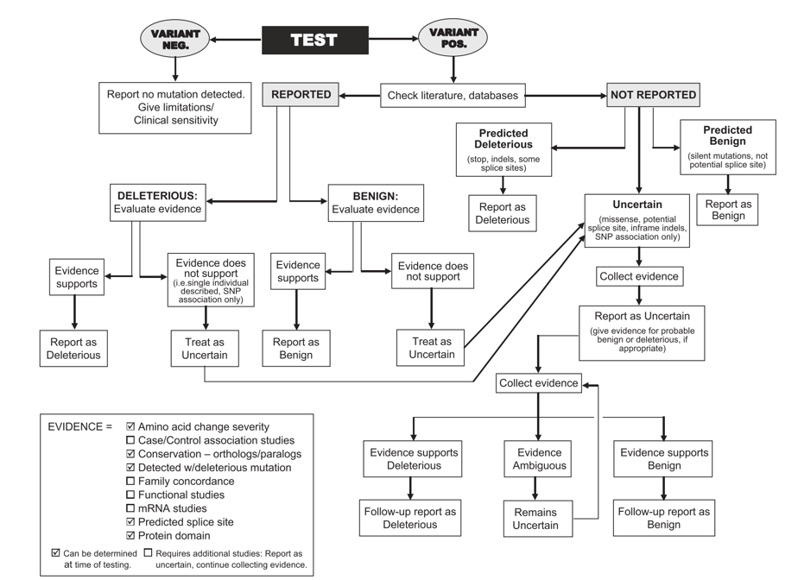
ACMG Recommendations for interpreting and reporting sequencing variants
Diagnostic Yield

Slide 23



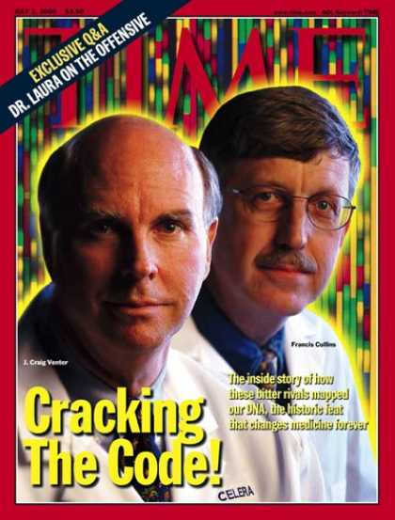
Integrating the literature
Huntington Disease
Menkes Disease
NF2
Tuberous Sclerosis
Alagille Syndrome
Angelman
Deafness 1
APC
Aniridia
Fragile X
Ataxia Telangiectasia
Bloom syndrome
SMA
GO-ESP
1000G Phase 1
1990
Myotonic Dystrophy
Norrie Disease
Hemochromatosis
Long QT
PKD2
Treacher Collins
Wolfram
Retinis Pigmentosa
Deafness 5
2000
2010
2012
Achondroplasia
BRCA1
PKD1
Adapted from http://www.ndsu.edu/pubweb/~mcclean/plsc431/ homework/positional-cloning/

Slide 24
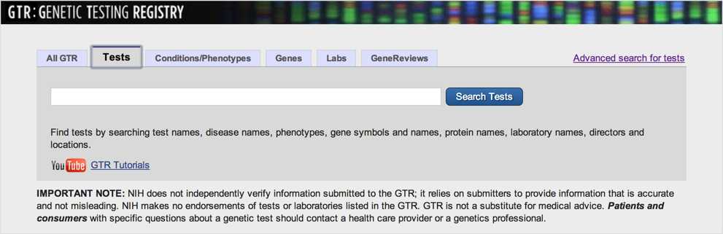
Gene Panels
Sanger sequencing of entire coding sequence: 9,589
NGS sequencing of entire coding sequence: 1,451
http://www.ncbi.nlm.nih.gov/gtr/

Slide 25
Diagnostic Yield: Gene Panels
Non-Syndomic Hearing Loss
Noonan
GLA
10%
Long-QT
Alagille (JAG1)
100%
Laboratory for Molecular Medicine
Lieve et al., 2013

Slide 26
Diagnostic Yield: Exome
Personalis Data (56 cases)
Yang et al., 2013
Numerous ACMG abstracts
Numbers reported across labs
25-56%

Slide 27

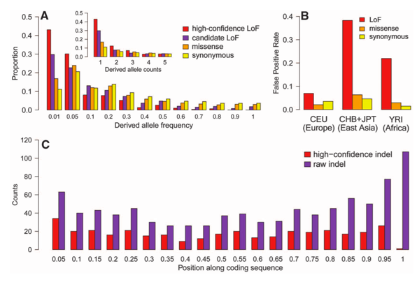
MacArthur et al., 2012

Slide 28
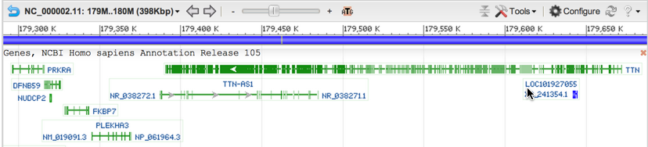
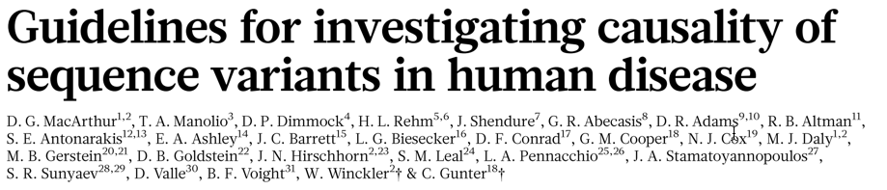
Statistical models to evaluate significance

Slide 29
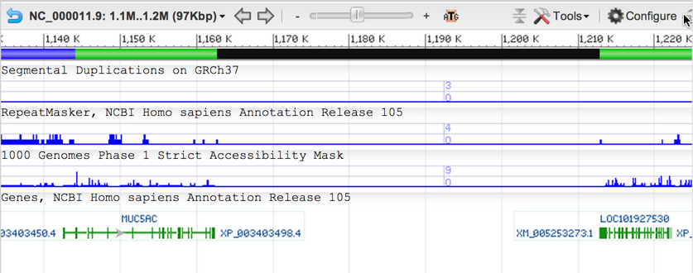
Statistical models to evaluate significance
Missing Mucin paralogs

Slide 30

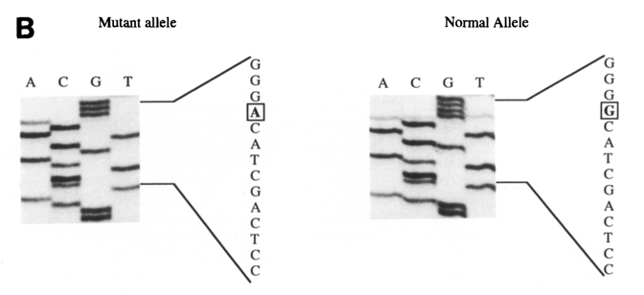
Integrating the literature
1994

Slide 31
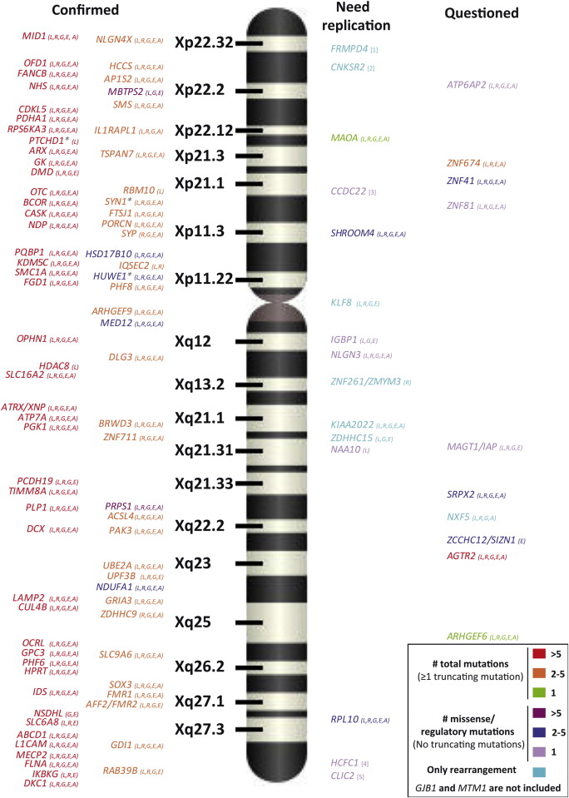
Piton et al., 2013
XLID-Causing Mutations and Associated Genes Challenged in the Light of Data from Large-Scale Exome Sequencing
10/106: questioned
15/106: need replication

Slide 32
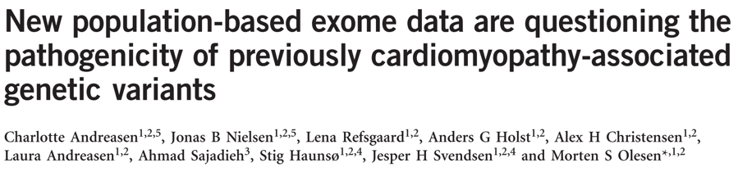
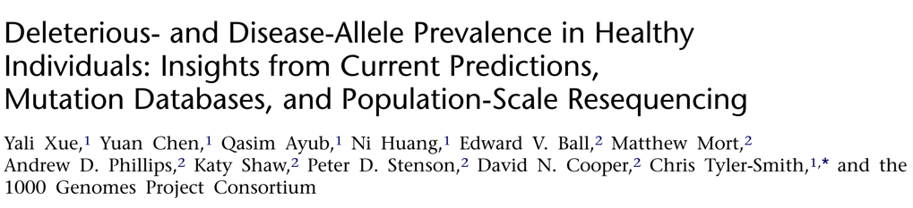
Integrating the literature

Slide 33
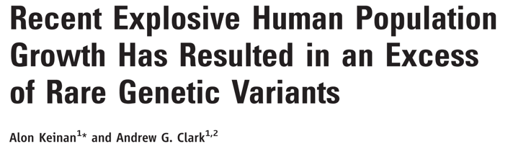
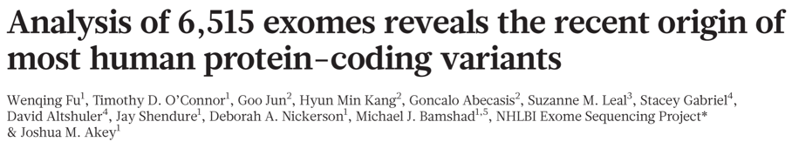
Integrating the literature

Slide 34
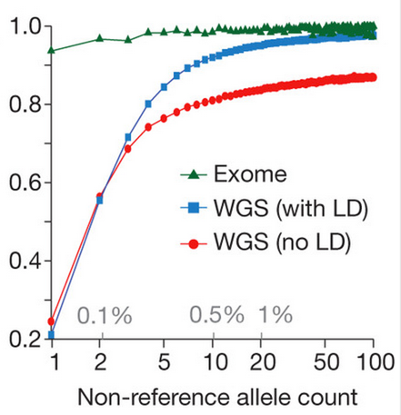
Rare variants
Power to detect SNPs
Figure 1b. 1000 Genomes Consortium, Nature 2012

Slide 35
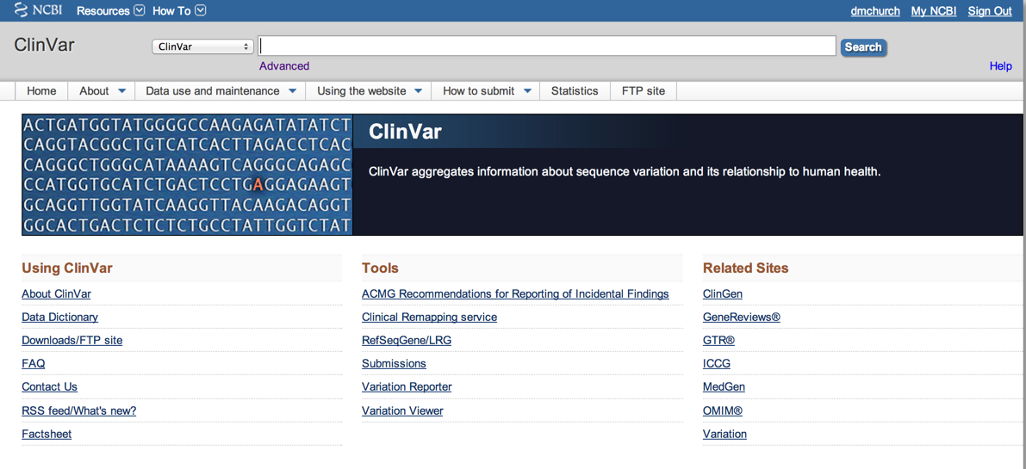
ClinVar
http://www.ncbi.nlm.nih.gov/clinvar/

Slide 36
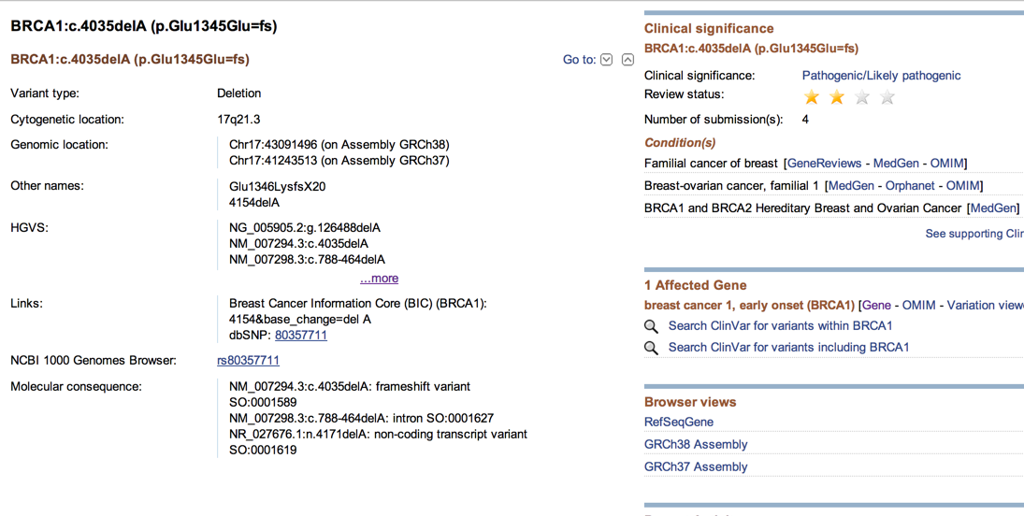
ClinVar
Key is the variant-phenotype relationship
Variants defined in archives (dbSNP/dbVar)

Slide 37
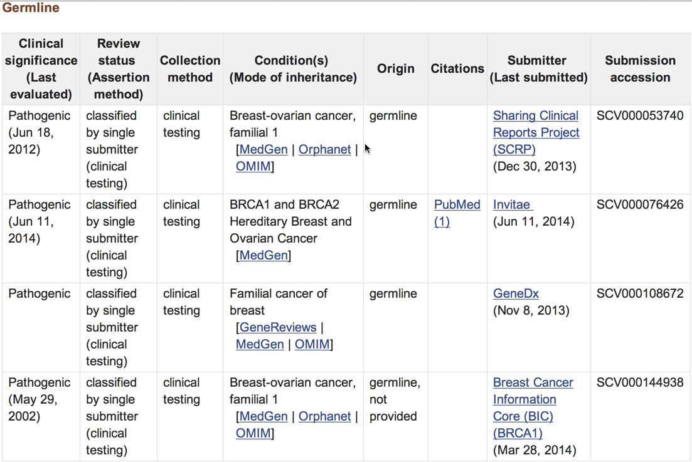
ClinVar

Slide 38
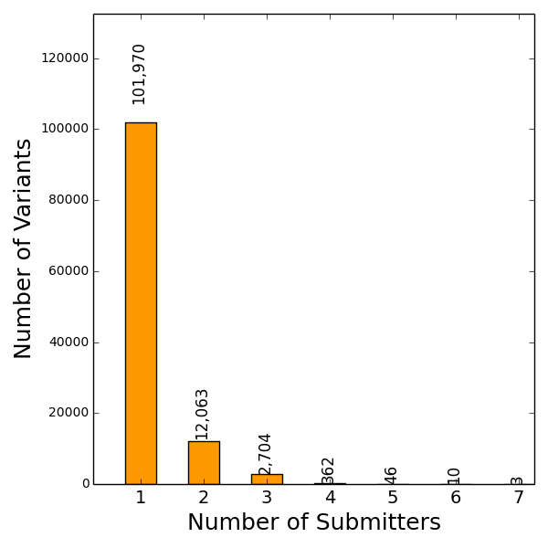
Evaluating Variants: ClinVar
Based on variant_summary.txt (May 20, 2014)

Slide 39
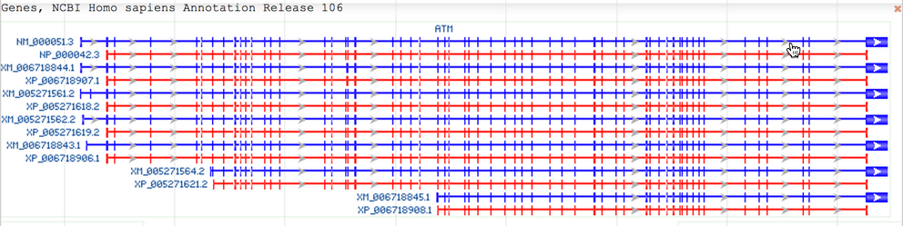
Communicating knowledge
ATM: 5762ins137
“137 nt added between exons 40 and 41”
McConville et al., 1996

Slide 40
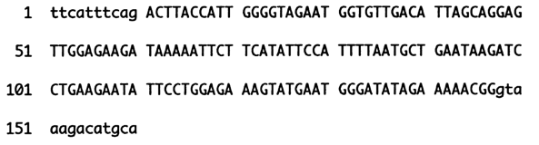

Communicating knowledge
Exon 38
Exon 39

Slide 41

Communicating knowledge
NC_000011.9 (chr11) 108179684
C>G

Slide 42

Communicating knowledge
LMNA:
c.82C>T; p.R28W
Turk et al., 2013

Slide 43
Communicating knowledge
Ref
AGATTCAC
Alt
AGATTTCAC
Valid VCF (left shift):
#CHROM POS ID REF ALT QUAL FILTER INFO
22 3 123 A AT . . .
Valid HGVS (right shift):
chr22:g.5dupT
NOTE: Better to use NC_000022.10 instead of chr22/22

Slide 44

Communicating knowledge
ClinVar Variant Genomic Locations

Slide 45

Communicating knowledge
NCBI Homo sapiens annotation run 105
Ensembl 74
McCarthy DJ, et al., 2014

Slide 46

Take home messages
More Sequence
Better Phenotyping
More precise data handling

